Slide 1
Outlook for the US Economy Over the Coming Year
Prof. Steven Kyle
Cornell University
December 2015

Slide 2
Grading My Predictions from Last Year
Most economists are taught to avoid naming both a number and a date
I do it anyway every year and post the results on my website
How did I do last time?

Slide 3
My forecast: “another year of 3%; biggest caveats overseas”

Slide 4
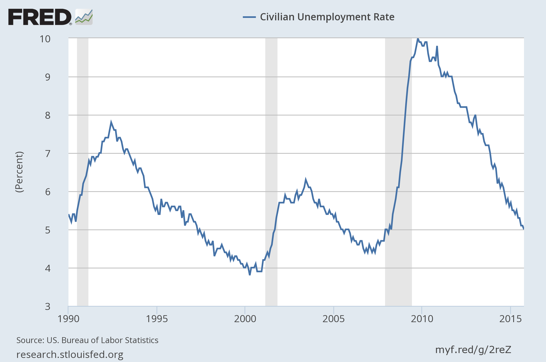
My forecast: “ … 5-5.5%”

Slide 5
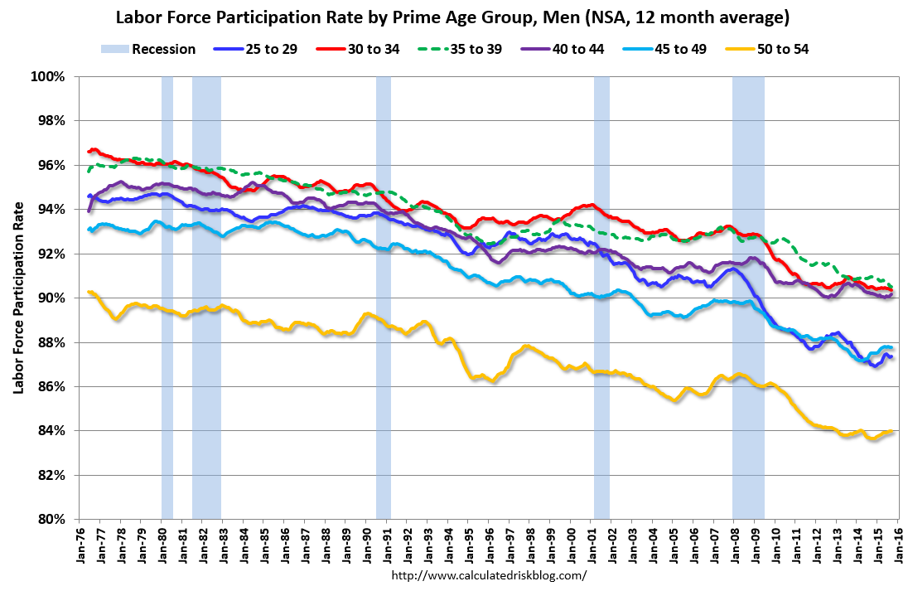

Slide 6
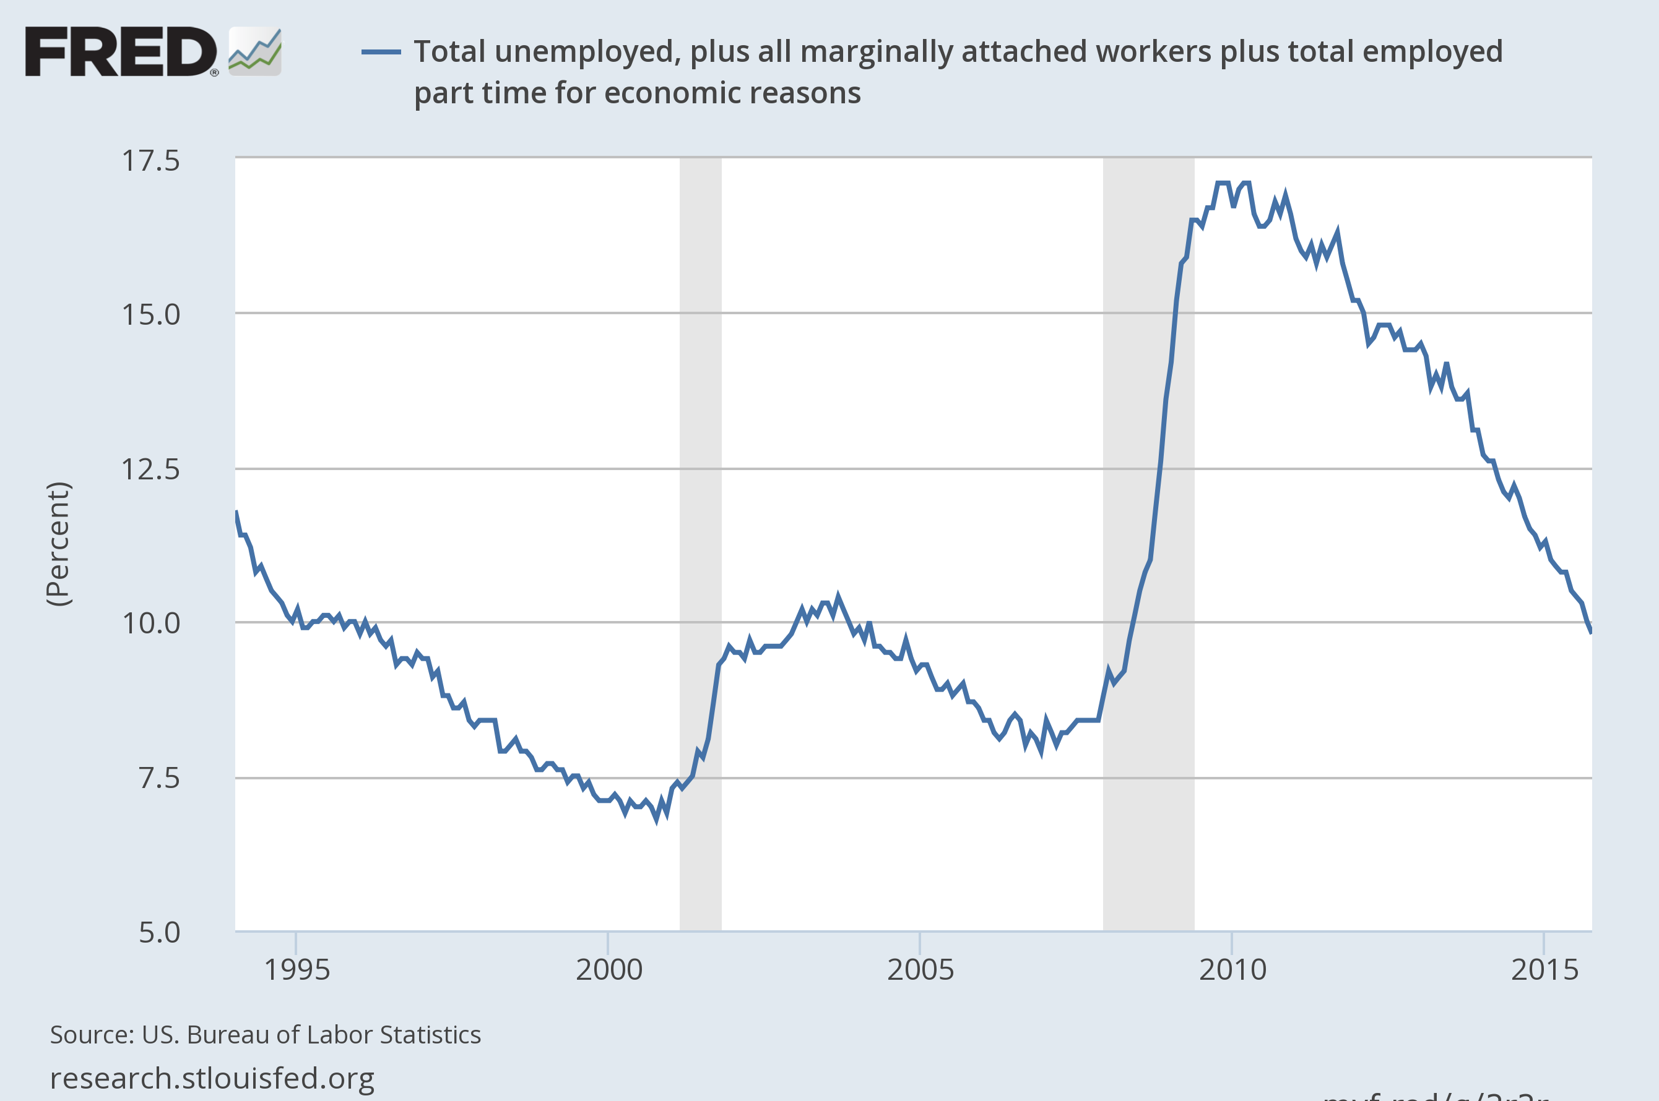
U6 still high but headed in the right direction …

Slide 7
My forecast: “not a shred of evidence of inflation”

Slide 8
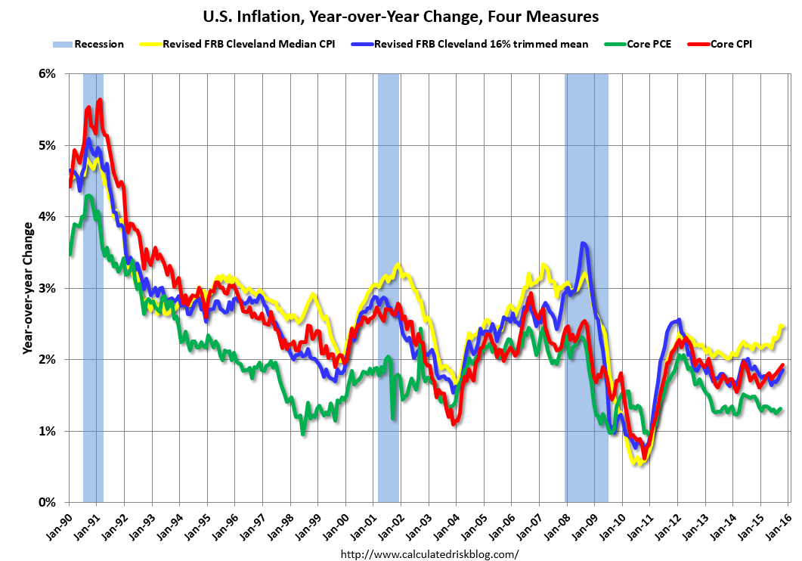

Slide 9
My forecast: “1% or less (probably less)”

Slide 10
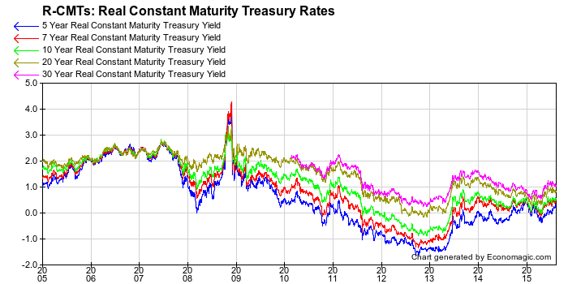
“…Long rates may creep up”

Slide 11
Housing Market
It was the source of the mayhem in 2008-09
Continues to gradually stage a comeback
Real estate a slow moving market at best of times

Slide 12
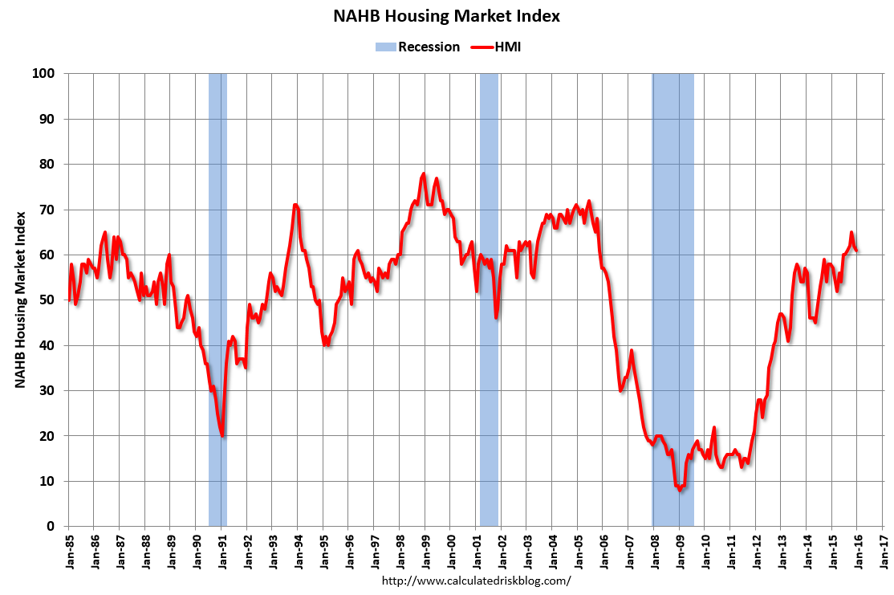
Overall Market Getting Back to Normal

Slide 13
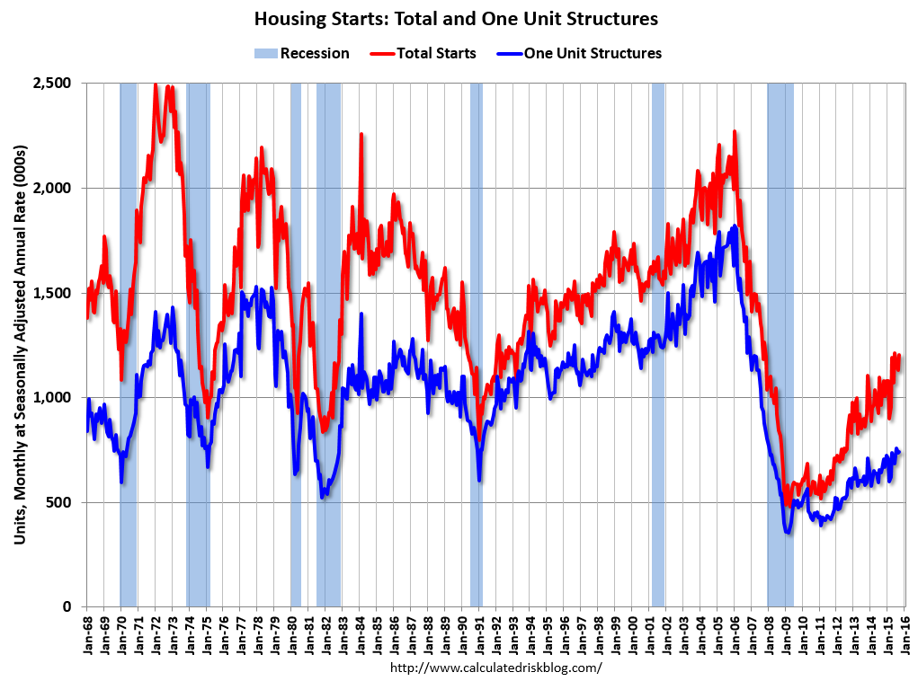
Overall Starts Back to Bottom of “Normal” Range: Single Family Not Yet

Slide 14
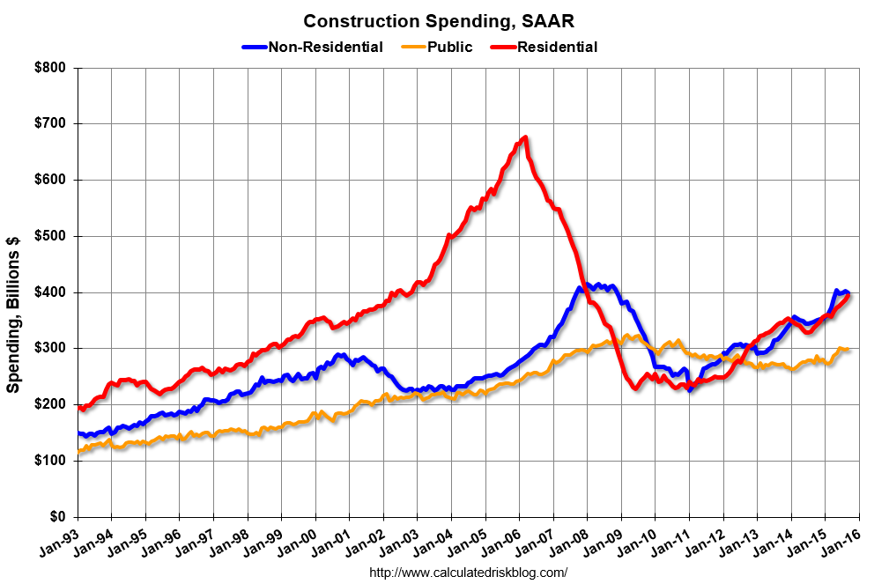
Public Sector Lagging

Slide 15
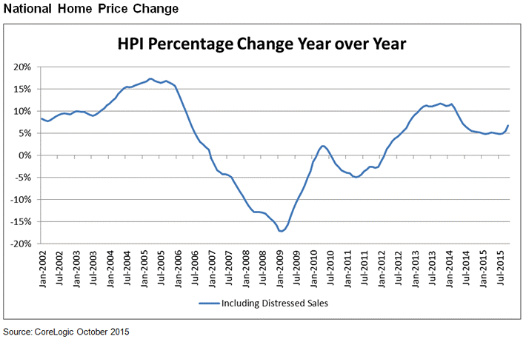
Cooling Off but Still Going Up …

Slide 16
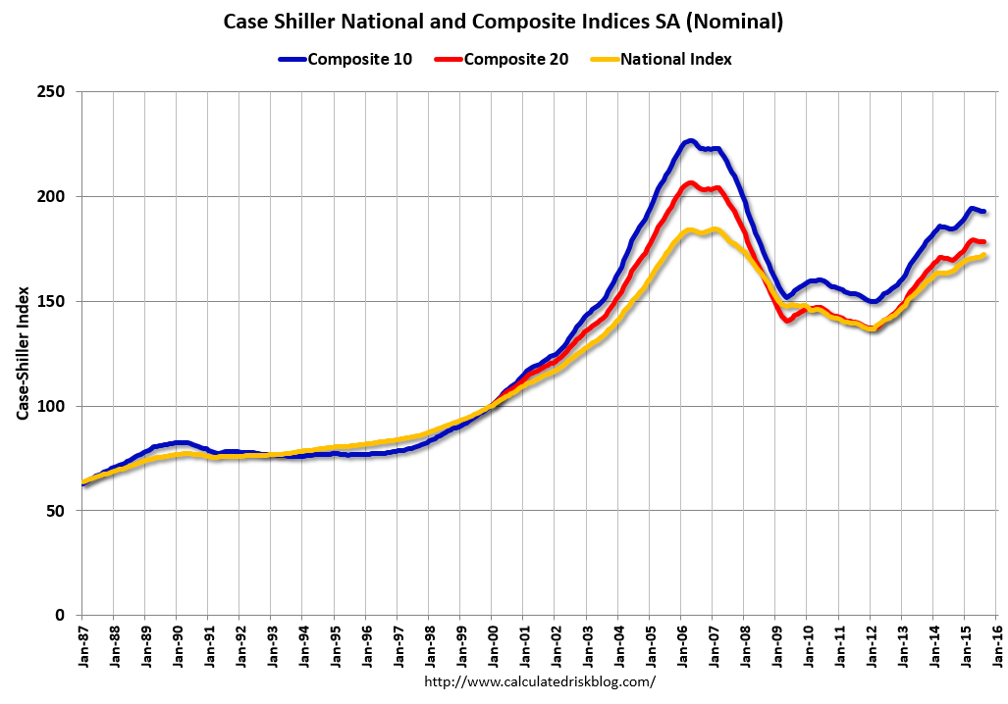

Slide 17
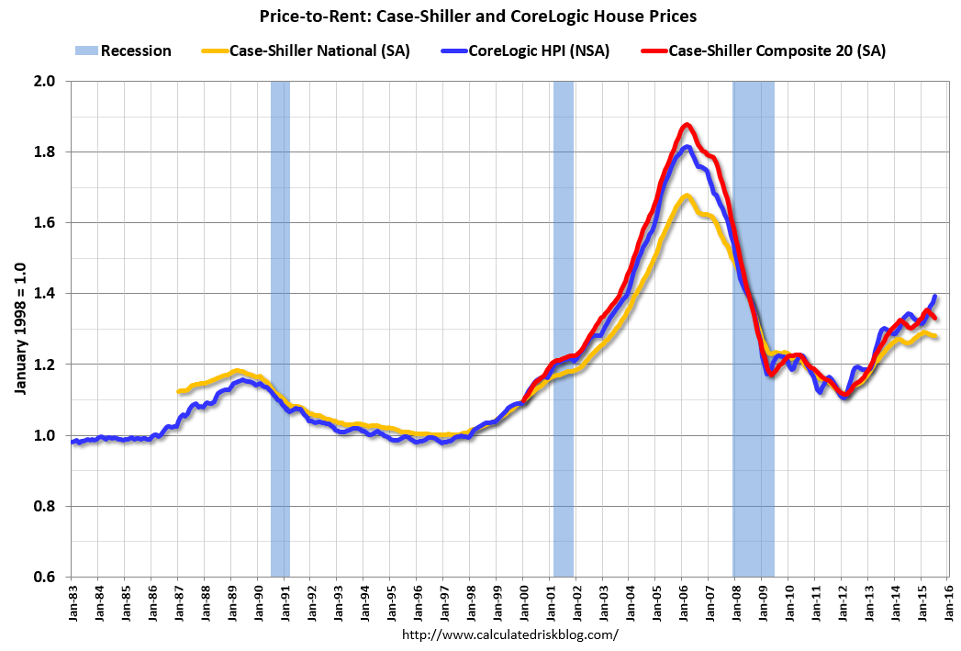

Slide 18
Where are we now in the business cycle?
Still on the upswing though still more gradual than we might like
Coincident and Leading Indicators still in the green

Slide 20
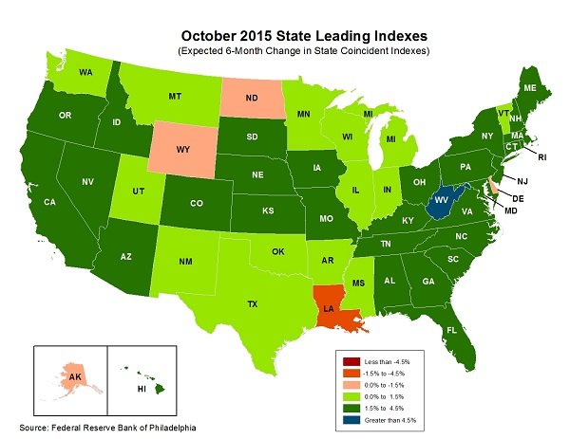

Slide 21
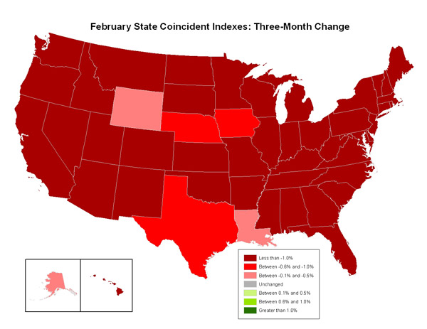
February 2009

Slide 22
Still Slack in the Economy
No sign at all of inflation
Labor market the key
  Already saw the lack of wage pressure
  Seem to be a “reserve army” of unemployed
  Minimum wage debate getting a bit more prominent
  Latest jobs report good

Slide 23
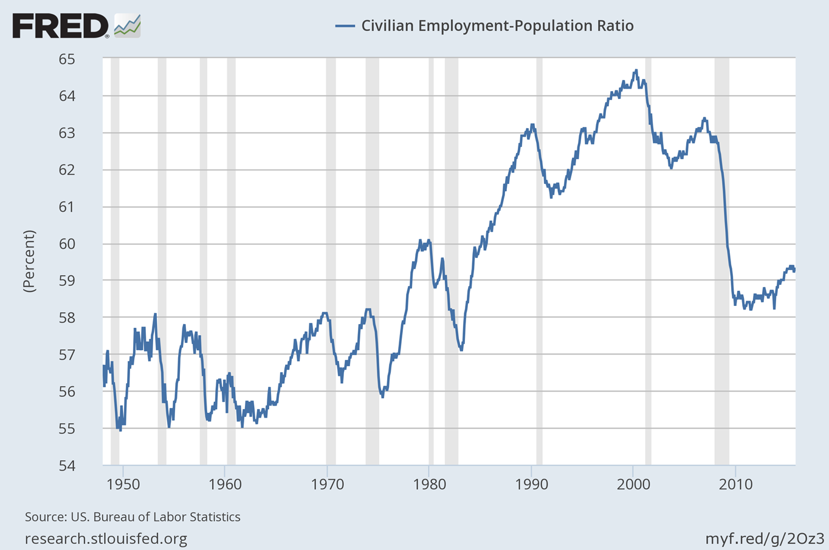
Some movement but still a lot of slack

Slide 24
Industrial Production and Capacity
Industrial production continues to rise past previous peaks
Note – Corporate profits fine, but no purchasing power additions to wage earners
Capacity utilization going sideways at best
No expectation of big investment surge from private sector

Slide 25
Industrial Production Still Higher than Previous Peak But Levelling Off?…

Slide 26
… Capacity Utilization Still Below 80% and Drifting Lower

Slide 27
Households
Wages pretty flat
Consumer spending looking a bit droopy

Slide 28
No Sign At All of Real Wage Inflation

Slide 29
Consumer Spending Rising But at Decreasing Rate

Slide 30
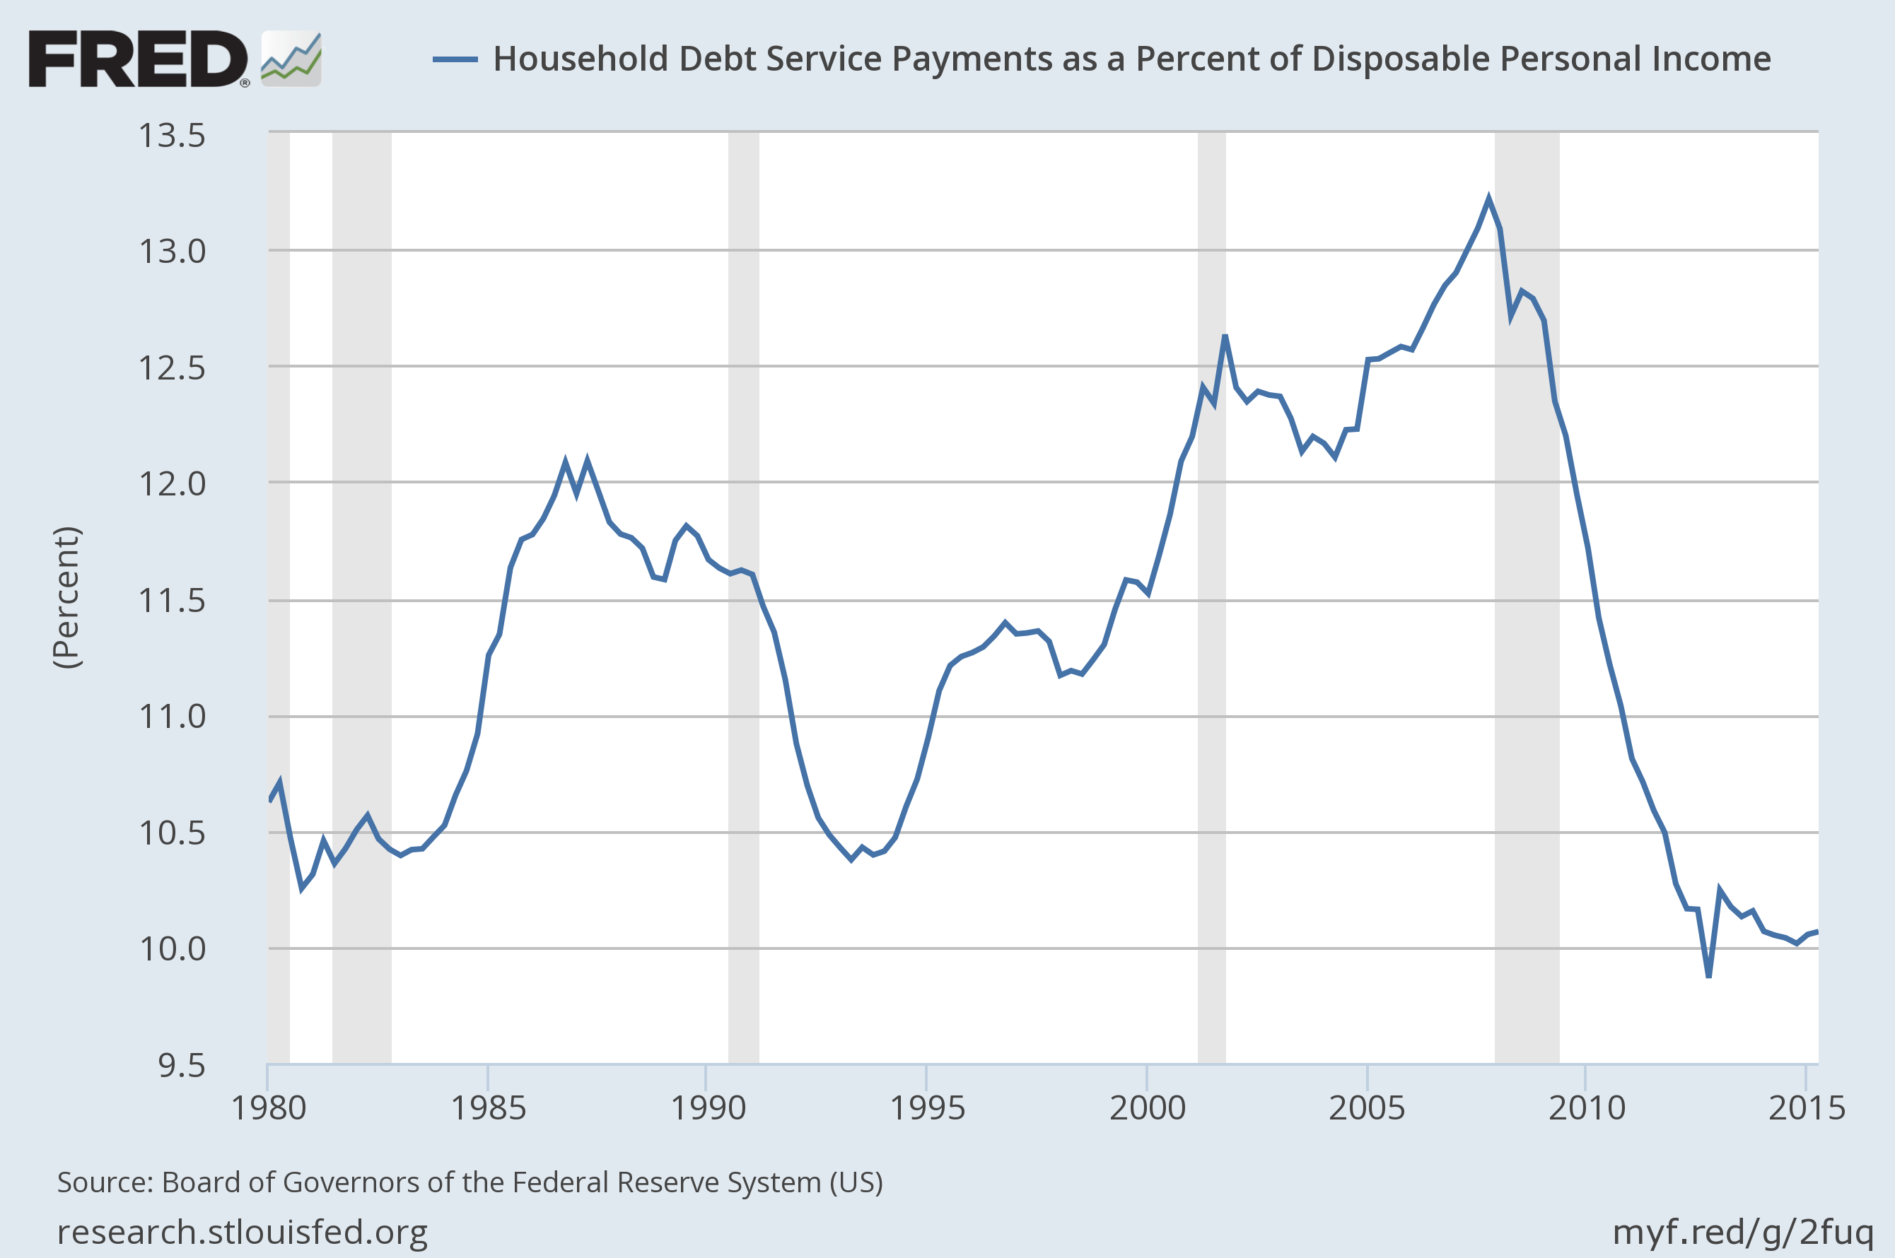
Household Debt Still at Historically Low Levels

Slide 31
Monetary Policy
Monetary Policy Still Extremely Expansionary
  “Extraordinary” measures gone but short rates still very low
  Yes, Fed did raise short rates a quarter of a percent
    Psychologically important
    NOT a response to inflationary pressure – There isn’t any
    Not a major change in real costs
    Gradual is the key word
    Yes, they can indeed reverse course at any time

Slide 32
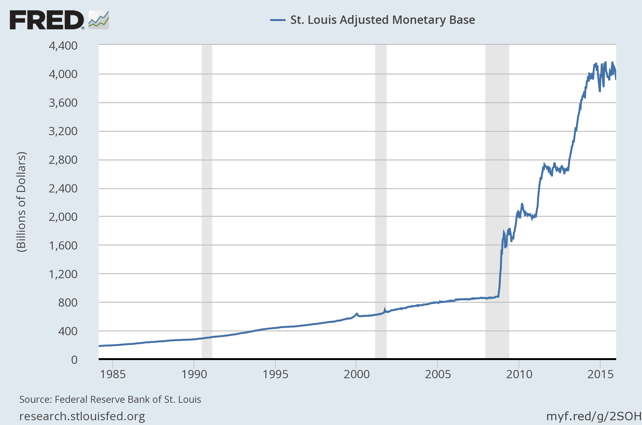
Don’t Worry About This Scary Chart! Really!

Slide 33
Why? Because There Really is More to it Than Simple Monetarism

Slide 34
Fiscal Policy
Fiscal “Policy” an ideological football
  We “should” be investing in infrastructure if interest rates are at zero
  What we ARE doing is mostly flatlining spending
  At least we won’t see shutdown any time soon

Slide 35
Fiscal Policy Continues to Contract

Slide 36
Europe One of Two Wild Cards
Most recent Greece “agreement” shows the naked political power play at work
Policy cannot possibly work
My continuing worry: Continuation of policies that generate Great Depression levels of unemployment discredit centrist politicians

Slide 37
The IMF Says The Greek Deal Is Not Viable
“I remain firmly of the view that Greece’s debt has become unsustainable and that Greece cannot restore debt sustainability solely through actions on its own,” the I.M.F.’s chief, Christine Lagarde, said on Friday, following the accord’s approval this week.

Slide 38
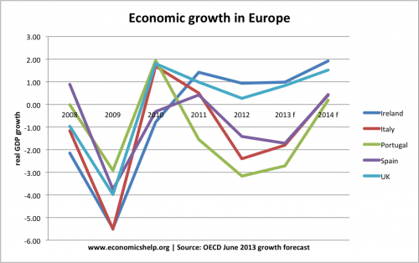
Growth Still Anemic in Europe

Slide 39
Second Wild Card: China
Volatility in Stock Market Worrying
  Authorities seem to imagine they can control it
“Only” 6.9% GDP growth
Problem: Who believes these statistics?
Even Bigger Problem: Shadow financial sector
How do unregulated financial sectors “self correct”?? – Through periodic crashes!

Slide 40
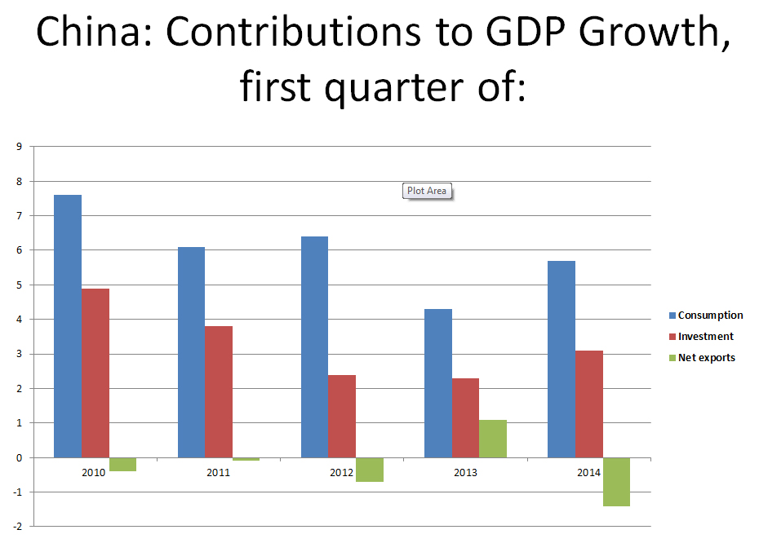

Slide 41
Outlook for Policy
Monetary Policy will be continuation of the present expansionary low interest policy until there is evidence of inflation. The just announced quarter percent increase still leaves short rates “low”. Key for next year is just what they mean by “gradual” increases.
Fiscal Policy is back from the cliff of insanity. However, we NEED investment but seem to be getting only marginal changes.
Fiscal paralysis from here on out is likely

Slide 42
Predictions
GDP growth at 2.0%; lower if rates go up much
Unemployment 5% plus or minus a half %
Inflation – Not a worry
Interest rates – Fed will likely allow a rate increase or two in next year – but only a ¼% at a time
Fiscal Policy? No change until October of next year
Europe – Staved off disaster yet again
China – It will be a surprise when it comes

